Slide 1
Graphic Presentation of Data
By
Dr. Fouad Metry
Assistant professor of community medicine – Sohag faculty of medicine

Slide 2
Meaning of graphical representation of data
A picture is said to be more effective than thousand words for describing a particular thing.
A graphic representation is the geometrical image of a set of data.

Slide 3
It is a mathematical picture.
It enables us to think about a statistical problem in visual terms.
It is an effective and economic device for the presentation, understanding and interpretation of the collected data.

Slide 4
mportance of graphical representation:
It is used to make the data understandable to common man.
It helps in easy and quick understanding of data.
Data displayed by graphical representation can be memorized for a long time and can be compared at a glance.

Slide 5
Types of graphs
Dot plots *Line graph
Bar chart *Frequency Histogram
Frequency polygon
Frequency Curve
Pie chart * Box Plot

Slide 6
Dot Plots
The dot plot is one of the simplest ways of graphical representation of the statistical data.
As the name itself suggests, a dot plot uses dots to display a graph which usually compares frequency within different categories.

Slide 7
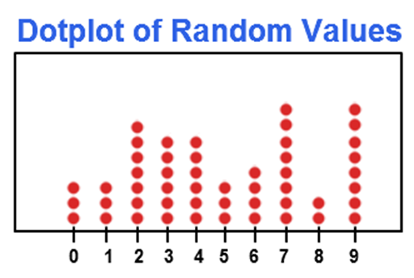

Slide 8
In the dot plot, every dot denotes a specific number of observations belonging to a data set.
One dot usually represents one observation. These dots are to be marked in the form of a column for each category.

Slide 9
.In this way, the height of each column shows the corresponding frequency of some category.
The dot plots are quite useful when there are small amount of data that is given within the small number of categories

Slide 10
Example: Draw a dot plot for the following data.
Favorite Colors | Red | Blue | Green | Yellow | Orange | Indigo | Violet
Number of Students | 9 | 7 | 5 | 3 | 2 | 1 | 3

Slide 11
Solution

Slide 12
Line graph
Line graphs are simple Mathematical graphs that are drawn on a graph paper by plotting the data connecting one variable on the horizontal X- axis and other variable of data on the vertical Y-axis.

Slide 14
The line graphs are used in the science, statistics and media.
Line graphs are very easy to create.
These are quite popular in comparison with other graphs since they visualize characteristics revealing data trends very clearly.
A line graph can give a clear visual comparison between two or more variables which are represented on X-axis and Y-axis

Slide 15
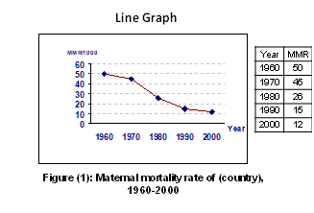

Slide 16
Bar graph
In bar graphs data is represented by bars.
The bars can be made in any direction i.e. vertical or horizontal. The bars are taken of equal weight and start from a common horizontal or vertical line and their length indicates the corresponding values of statistical data.
The width of all bars should be equal, so are the distances among different bars.

Slide 17
Bar graphs may be simple or grouped bar charts (multiple or multiple component bar charts).
When do we use bar chart?
When the data are given in whole numbers (Q. discrete variables)
In case of qualitative variables.

Slide 18
Simple bar chart

Slide 19
multiple bar

Slide 20
multiple component bar

Slide 21
Histogram and Frequency Polygon:
The histograms and frequency polygons are very common graphs in statistics.
A histogram is defined as a graphical representation of mutually exclusive events. A histogram is quite similar to the bar graph. Both are made up of rectangular bars.

Slide 22
The difference is that there is no gap between any two bars in the histogram.
Histograms can be constructed for equal as well as unequal class intervals. Area of any rectangle of a histogram is proportional to the frequency of that class
The histogram is used to represent continuous data

Slide 24
The frequency polygon is a type of graphical representation which gives us better understanding of the shape of given distribution.
Frequency polygons serve almost the similar purpose as histograms do.

Slide 25
But the frequency polygon is quite helpful for the purpose of comparing two or more sets of data.
The frequency polygons are said to be the extension of the histogram. The frequency polygon is made When the midpoints of tops of the rectangular bars are joined together

Slide 27
A frequency polygon is essentially a line graph.
We can get it from a histogram, if the mid points of the upper bases of the rectangles are connected by straight lines.
But it is not essential to plot a histogram first to draw it. We can construct it directly from a given frequency distribution.

Slide 28
When do we use Frequency polygon?
When the variables are continuous.
When two or more groups have to be displayed in one diagram

Slide 30
Frequency Curve
Frequency curve is another type of graphical representation of data.
It is constructed when the top points of a frequency polygon are joined by curved lines instead of straight ones.
Frequency polygon is drawn using scale while frequency curve is drawn using free hand.

Slide 31
When do we use frequency curve?
When the number of class intervals are very large i.e., width of the class intervals are very small and the total number of sample values be increased indefinitely

Slide 33
Pie diagram (Circle Graph):
A circle graph is also known as a pie graph or pie chart.
It is called so since it is similar to slice of a "pie". A pie graph is defined as a graph which contains a circle which is divided into sectors.
These sectors illustrate the numerical proportion of the given data.

Slide 35
The arc lengths of the sectors, in pie chart, are proportional to the numerical value they represent.
Circle graphs are quite commonly seen in mass media as well as in business world

Slide 36
To draw a pie diagram, first the value of each category is expressed as a percentage of the total and then the angle 360⁰ is divided in the same percentages.
Then at the centre of a circle these angles are drawn simultaneously starting from a particular radius.
In this way we get a set of sectorial areas proportional to the values of the items.

Slide 37
A variant of the Pie chart is the Doughnut chart.

Slide 38
Box Plot
The box plot (a.k.a. box and whisker diagram) is a standardized way of displaying the distribution of data based on the five number summary:
minimum, first quartile, median, third quartile, and maximum. Usually this graph is created using computer statistical software

Slide 40
Thank you

